Slide 1
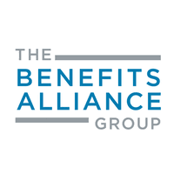
The ABCs of Compensation
Rahim Bhayani
Managing Director, Principle Rewards Consulting
December 1, 2021

Slide 2
The ABCs
Market Forces & Trends
Employee Value Proposition
Market Competitive Positioning
Total Rewards Framework
Tax Efficiency & Dollar Optimization
Compensation Plan Design
Pay Transparency & Comms
Now what???

Slide 3
The ABCs
Market Forces & Trends
Employee Value Proposition
Market Competitive Positioning
Total Rewards Framework
Tax Efficiency & Dollar Optimization
Compensation Plan Design
Pay Transparency & Comms
Now what???

Slide 4
Market Forces & Trends
Tightest labour markets (globally) – in my 20+ years in Compensation, I have never seen it be so tilted in favour of the employee.
Remote work is creating a global pool of talent…in Canada, this is practically showing up as Canadians living in Toronto or Montreal but working remotely for US based companies…this means employers in Canada are facing and will continue to face higher employee costs.
Tech companies are throwing large packages to employees, with a focus on pre-IPO stock options…pre-IPO equity is considered very desirable now. There are a lot of data points now on how employees can “hit the jackpot” by doing the pre-IPO circuit…this means that if you are a slow-growth Manufacturing company or a high growth tech company, you are potentially competing for the same “middle office” talent ( HR, Accounting, Finance, Marketing, IT, Legal etc). That talent is headed for Tech!

Slide 5
Market Forces & Trends
Companies are getting very creative with non-cash components of work – recognition, work flexibility, work tools, meaningful time off, volunteer opportunities, mission-led work, well-being initiatives and programming, etc. Significant “curating” of employee rewards experience is happening in small, medium and enterprise level businesses.
Democratization of compensation data is very real…salary.com, et al. This is being exacerbated by legislation (US in particular) that forces companies to provide compensation ranges.
Pay equity is a very big deal now and employees are getting educated on the fact that companies need to provide compensation that is free from bias. This means employers absolutely need to ensure they review compensation with a gender and race lens and laser-focus on meritocracy.

Slide 6
Market Forces & Trends
Inflation is persistent and it is making its way from the grocery store and gas station to labour costs. Cost of labour and cost of living are highly correlated…in other words, you cannot have a high cost of living location that also has cheap labour. Inflation is going to put a lot of upward pressure on wages at a time when the pandemic has created a lot of business and economic volatility.
Companies are looking to tap into “smart” ways to enhance ROI on compensation without spending more money. An example of that could be being very clear on communicating the full package of their total rewards, including looking “under the rocks.” For example, ensuring employees understand RRSP matching or health spending account (HSA) balances or vacation time.

Slide 7
The ABCs
Market Forces & Trends
Employee Value Proposition
Market Competitive Positioning
Total Rewards Framework
Tax Efficiency & Dollar Optimization
Compensation Plan Design
Pay Transparency & Comms
Now what???

Slide 8
Employee Value Proposition
Do employees actually understand their compensation, especially the non-cash components? So, for example, employees with a spouse and three dependent children rarely understand that a company-paid benefits plan can be worth $25,000 ($5,000 × 5). Also, these benefits are tax optimized in many cases.
Can employees explain how they get paid to a spouse or colleague in really simple terms? If not, it is a huge missed opportunity because they likely do not understand how and what they get paid for.
Is there a unique, compelling feature(s) in the company’s compensation design that creates a draw for an employee that may be recruited by peers / competitors?
How does a company go about calculating non-cash benefits $ per employee?

Slide 9
The ABCs
Market Forces & Trends
Employee Value Proposition
Market Competitive Positioning
Total Rewards Framework
Tax Efficiency & Dollar Optimization
Compensation Plan Design
Pay Transparency & Comms
Now what???

Slide 10
Market Competitive Positioning
Market Competitive Positioning simply means the conscious placement of a company’s compensation levels relative to competitors for business or talent.
Positioning is defined in terms of “percentiles.” So, for example, if a company positions itself at the 75th percentile of the market, this means that they pay better than 75% of the companies that they compete with for business or talent.
A very typical positioning would be “Median” or 50th percentile, which means the company pays better than 50% of the companies that they compete with for business or talent. This is the safe, “middle path”!

Slide 11
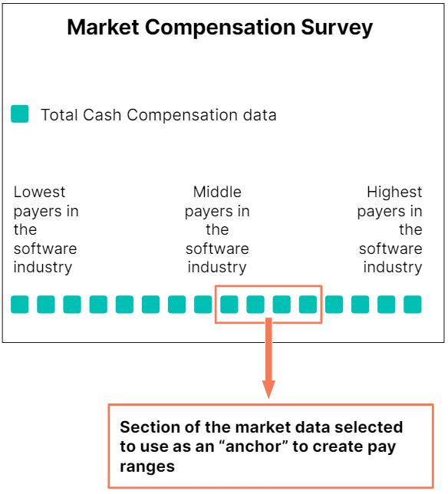
Market Competitive Positioning
Does a company consciously target a particular “position” in the market? P25 – P50 – P75: Does a company have a reliable annual way to understand the market data?
Does a company have access to a compensation consultant (in-house or external) to interpret and understand the data?
Does a company have the wherewithal to convert market data into stable, consistent pay frameworks (pay ranges).

Slide 12
Market Competitive Positioning
Towers Watson, Mercer, Radford, etc. or Custom Surveys. All have their pros and cons. Companies need to understand which data source fits best and that may change depending on the company life cycle.
Specific peer group or “all industry” data cuts? Market data has a lot of nuance and technical aspects to consider. This stuff needs to be agreed upon in a framework and then followed YoY, otherwise there is no comparability.
Companies need to think about a long-term strategy to reliably know the competitiveness of their compensation program, including partnering with the people that have the market data.

Slide 13
The ABCs
Market Forces & Trends
Employee Value Proposition
Market Competitive Positioning
Total Rewards Framework
Tax Efficiency & Dollar Optimization
Compensation Plan Design
Pay Transparency & Comms
Now what???

Slide 14
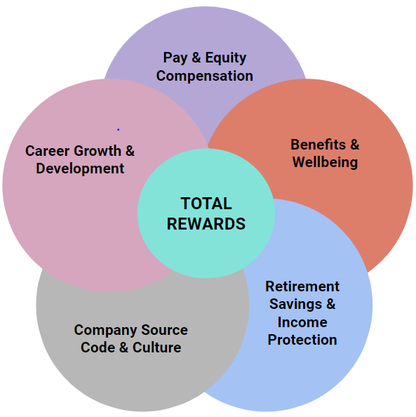
Total Rewards Framework
Base++ or Total Compensation approach
Total Compensation or Total Rewards
Do employees understand the company’s rewards pie?

Slide 15
Total Rewards Framework
Base++ approach
Base Salary
+
Cash Bonus
+
Long-Term Incentives
=
Total Compensation
Total Compensation approach
Total Compensation
=
Base Salary
+
Cash Bonus
+
Long-Term Incentives
Total Rewards
Total Rewards
=
Total Compensation
+
Health Benefits
+
Retirement Plan

Slide 16
The ABCs
Market Forces & Trends
Employee Value Proposition
Market Competitive Positioning
Total Rewards Framework
Tax Efficiency & Dollar Optimization
Compensation Plan Design
Pay Transparency & Comms
Now what???

Slide 17
Tax Efficiency & Dollar Optimization
Cash Compensation may not be as tax efficient as other elements of Total Rewards, such as a Health Spending Account (HSA) or an RRSP match. Even small and mid-sized companies need to have all the components available to employees.
Other compensation elements may be more efficient but don’t pay the mortgage, so there needs to be a balance between Base Salary and other rewards elements. Companies need to be conscious of these trade-offs and actually understand how much they invest in a given year in each of the buckets (HINT: Most companies are not aware of how much they spend in total rewards beyond the biweekly payroll runs).
Companies have not yet figured out Total Rewards Statements, which is a huge missed opportunity to break down how much a company invests in employees beyond the Base Salary number.

Slide 18
The ABCs
Market Forces & Trends
Employee Value Proposition
Market Competitive Positioning
Total Rewards Framework
Tax Efficiency & Dollar Optimization
Compensation Plan Design
Pay Transparency & Comms
Now what???

Slide 19
Compensation Plan Design
STIP vs. LTIP – both or just one? Long-term incentives are complex but also extremely incentivizing for employees. They completely align owners and employees n a way that cash bonuses simply cannot. Long-term incentives are also retentive at a time when attrition rates across all industries are high.
Using incentives appropriate to the industry is critical. For example, the tech industry is all about LTIP and not so much STIP…so it just depends.
Pay-for-Performance and funding the payout curves in a responsible way are important considerations. In a nutshell, significant analysis is required to ensure the company understands the math behind how much of the company’s earnings will be paid out in incentives.

Slide 20
Case Study: Aligning Incentives
A Canadian-based slow-ish growth company finally gave in and hired a professional Head of Sales. For the first 8 years, the company had relied upon the founders’ hustle to grow and that was not leading to the kind of accelerated growth the founders had envisioned.
So, in comes this fantastic and experienced Head of Sales and they start shaking things up in terms of lead generation, branding, marketing, product roadmapping, et…long story short, in 2 years, they were responsible for growing sales by 500% and bringing in 20+ new clients to the company’s customer ecosystem. As a result of this growth, the value of the company tripled in the span of those 2 years.
The company had a reasonable cash incentive plan based on meeting revenue target and a decent base salary, but they offered the Head of Sales no equity in the business, this critical employee did not participate at all in the significant value creation.
Do you think the Head of Sales stuck around or did they leverage their excellent performance into a bugger opportunity with real equity in the business?

Slide 21
The ABCs
Market Forces & Trends
Employee Value Proposition
Market Competitive Positioning
Total Rewards Framework
Tax Efficiency & Dollar Optimization
Compensation Plan Design
Pay Transparency & Comms
Now what???

Slide 22
Pay Transparency & Comms
Big movement towards transparency in how people get paid in North America. American companies are recruiting from Montreal, Toronto and Vancouver in droves. One of my US based clients took California based accountants and replaced them with equally qualified accountants in Winnipeg. US companies are more transparent in disclosing their pay ranges and as they hire more and more in Canada, there will be more dissemination of US compensation levels.
Companies are terrible at communicating pay to employees and have not yet figured out Total Rewards Statements, which is a huge missed opportunity to break down how much a company invests in employees beyond the Base Salary number.
Companies need to focus on big, wide-scope picture versus myopic communication. A merit increase conversation needs to become a conversation about career opportunities, professional development, total rewards and what an employee can expected in terms of total rewards for their next role.

Slide 23
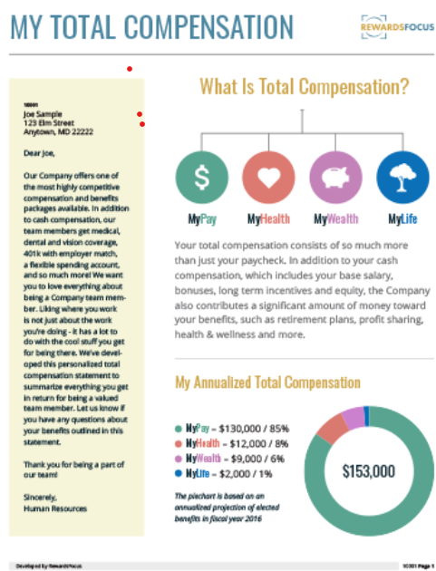
Pay Transparency & Comms
A very simple Total Rewards Statement, but very powerful because it reminds employees that there is more to it than base salary.
https://www.rewardsfocus.com/request-samples/

Slide 24
The ABCs
Market Forces & Trends
Employee Value Proposition
Market Competitive Positioning
Total Rewards Framework
Tax Efficiency & Dollar Optimization
Compensation Plan Design
Pay Transparency & Comms
Now what???

Slide 25
Ready for a Compensation Project?
How much does a good compensation consultant cost? A good high level ball-park is a blended rate of $200 / hour for a competent independent consultant and it can increase from there depending on the type of firm being used.
It is true that good compensation consultants are not plentiful and are not cheap! Projects can be “fixed fee” or on an hourly basis and both have pros and cons.
My advice is to understand the breakdown of the fees as much as possible and comparing fee quotes between at least two consulting shops.
Feel free to explain to the consultants that this could be a long-term partnership rather than a “one and done,” so that they can take that into account when pricing the project. The prospect of a long-term stable / growing partnership is worth a ~10%+ discount on the overall price.

Slide 26
Ready for a Compensation Project?
Make sure you know what market data sources the consultant has access to (if at all). In many cases, the client is expected to participate in a compensation survey, thereby unlocking the ability to purchase the published survey results. The cost of purchasing market data should always be factored into the company’s project cost assumptions.
High quality market data is not cheap and clients can expect to pay ~$5,000+ for access to a comprehensive survey with 100+ job positions.
Make sure other terms and conditions make sense, such as the external data sources they will use and the terms and conditions, especially if things go wrong in the project.
Call references if it’s a consultant you have never worked with to ensure you minimize issues that may arise later.

Slide 27
What kind of project should we embark on?
Early Stage / Start-up Stage / Small-Scale
More Mature / Mid-size
More Mature / Mid-size
Early Stage / Start-up Stage / Small-Scale
More Mature / Mid-size
More Mature / Mid-size
Market competitive analysis
Compensation ranges
Ensuring Base Salary is appropriate and engages / retains employees
Short term incentive plan (STIP)
Total Compensation statements
Setting up annual compensation review processes (merit cycle, etc)
Long term incentive plan (LTIP)
Total Rewards statements
HR Technology / HRIS
HR Analytics
+++

